Slide 1
Endocrine Pancreas
Dr Reshmy K.R
Professor
Dept. of Physiology
SKHMC

Slide 2
Endocrine pancreas
The pancreas is a long, slender organ, most of which is located posterior to the bottom half of the stomach.
Pancreatic islets—clusters of cells formerly known as the islets of Langerhans—secrete the hormones glucagon, insulin, somatostatin, and pancreatic polypeptide (PP).

Slide 3
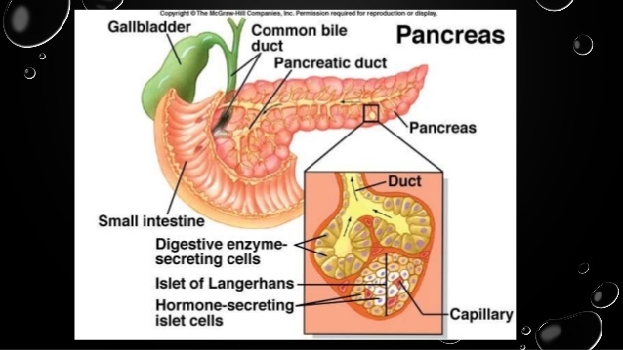
Endocrine Pancreas

Slide 4
The pancreas is composed of two major types of tissues.
(1) the acini, which secrete digestive juices into the duodenum
(2) the islets of Langerhans, which secrete insulin and glucagon directly into the blood.

Slide 5
Endocrine Pancreas-Islets of Langerhans
The human pancreas has 1 to 2 million islets of Langerhans,
Each about 0.3 millimeter in diameter
Organized around small capillaries into which its cells secrete their hormones.
The islets contain three major types of cells, alpha, beta, and delta cells, which are distinguished from one another by their morphological and staining characteristics.

Slide 6
Beta cells consitute of 60% of all the cells of the islets
- lies mainly in the middle of each islet secrete insulin and amylin.
Alpha cells, about 25 % of the total, secrete glucagon.
Delta cells, about 10 % of the total, secrete somatostatin.
PP cell, is present in small numbers in the islets , secretes a hormone pancreaticpolypeptide.

Slide 7
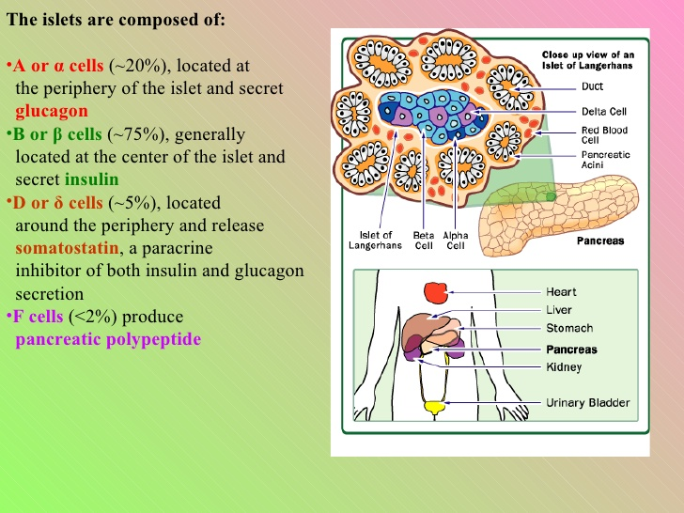

Slide 8
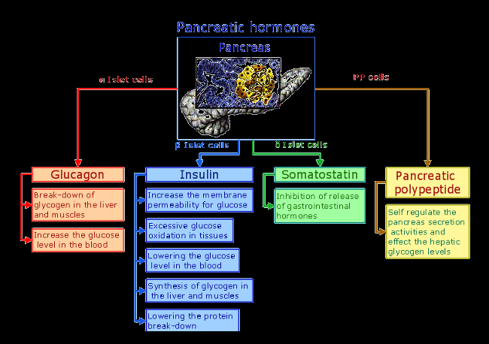

Slide 9
Insulin-chemistry
Insulin is a small protein.
Human insulin has a molecular weight of 5808.
Composed of two amino acid chains
When the two amino acid chains are split apart, the functional activity of the insulin molecule is lost.

Slide 10
Synthesis
Insulin is synthesized in the beta cells by protein synthesis
Beginning with translation of the insulin RNA by ribosomes attached to the endoplasmic reticulum to form preproinsulin.
Preproinsulin has a molecular weight of about 11,500,
cleaved in the endoplasmic reticulum to form a proinsulin with a molecular weight of about 9000 .

Slide 11
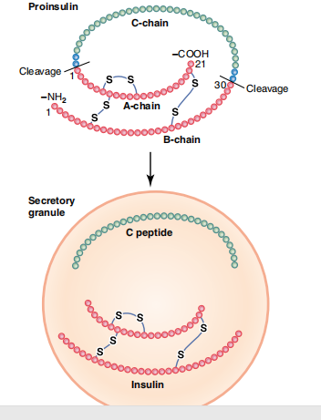
Proinsulin
consisit of 3 chains of peptidesA,B &C
Is further cleaved in the Golgi apparatus to form insulin, composed of the A and B chain connected by disulfide linkages, and the C chain peptide, called connecting peptide (C peptide).
The insulin and C peptide are packaged in the secretory granules and secreted in equimolar amounts.

Slide 12
Actions of Insulin
1. Effect on Carbohydrate metabolism
2. Effect on Protein Metabolism
3. Effect on Fat metabolism

Slide 13
I.Effect on Carbohydrate metabolism
1. Transport & Uptake of Glucose
Insulin is only antidiabetic hormone that reduces blood sugar level.
carbohydrate
blood sugar
insulin
Transport of glucose from blood into cells by increasing the permiability of cell membrane

Slide 14
Glucose is transported inside the cell by sodium glucose symport pump.
Glucose transporters - GLUT-4 is insulin sensitive, located in cytoplasmic vesicles, in muscles and adipose tissue.
Insulin receptor complex causes vesicles containing GLUT - 4 are attached to membranes glucose transporter released
transport glucose molecule from ECF into cell.

Slide 15
2.Peripheral Utilization of Glucose
Glucose entering the cell is oxidised by most of the cells immediately.
Rate of utilisation depends upon intake of glucose.

Slide 16
3. Storage of Glucose
Rapid conversion of glucose into glycogen (Glycogenisis) stored in muscles and liver.
Glycogen content is increased in liver beyond storing capacity, insulin causes coversion of glucose into fatty acid.

Slide 17
IV. Inhibition of Glycogenolysis
Prevents breakdown of glycogen into glucose in mucle and liver.

Slide 18
V. Inhibition of Gluconeogenesis
Formation of glucose from proteins by inhibiting the release of amino acid from muscles.
Inhibiting the activities of enzymes involed in gluconeogenesis.

Slide 19
Insulin decreases blood sugar level
Facilitating the transport and uptake of glucose by cells.
Increasing the peripheral utilisation of glucose.
Increasing the conversion of glucose into glycogen in liver and muscle.
Prevention of glycogenolysis
Inhibition of gluconeogenesis

Slide 20
Effect on protein metabolism - conservation and storage of protein.
Facilitates transport of amino acids into the cells from blood.
Increases permiability of cell membrane for amino acids.
Accelerates synthesis of proteins by influencing the transcription of DNA.
Increasing translation of mRNA.
Inhibites catabolism of protein by inhibiting the activity of cellular enzymes on protein.
Prevents gluconeogenesis by decreasing the release of AA from the cells.
Inhibiting the enzymes involed in gluconeogenesis.

Slide 21
Effect on fat metabolism
Synthesis of fatty acids and triglycerids.
Excess glucose is utilised for synthesis of fatty acids and triglycerids.
Synthesis of lipids by activating enzymes involed in conversion of glucose into fatty acids.
Conversion of fatty acids into triglycerides.

Slide 22
Transport of fatty acids into adipose tissue.
Storage of fat in adipose tissue by inhibiting the enzymes which degrade the triglycerides.

Slide 23
4. Effect on Growth
Action on anabolism of protein.
Transport of amino acids into cells and synthesis of proteins.
Conservation of proteins by accelerating the utilisation of glucose by the tissue.

Slide 24
Houssay Animal
Both Ant.pit and GH are removed.
Administration of either insulin or growth hormone alone does not induce growth in the animal.
Administration of growth hormone and insulin stimulate the growth which proves synergistic action of both hormone on growth.

Slide 25
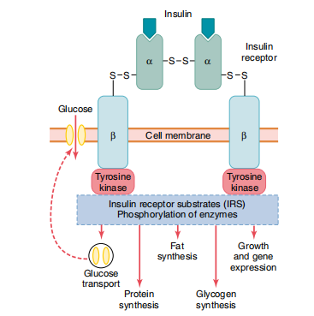
Mode of Action of Insulin
Insulin binds to the α-subunit of its receptor,
causes autophosphorylation of the β-subunit receptor, which in turn induces tyrosine kinase activity.
The receptor tyrosine kinase activity begins a cascade of cell phosphorylation that increases or decreases the activity of enzymes,
including insulin receptor substrates, that mediate the effects on glucose, fat, and protein metabolism.
glucose transporters are moved to the cell membrane to assist glucose entry into the cell.

Slide 26
Insulin activates a membrane receptor protein that has a molecular weight of about 300,000
It is the activated receptor that causes the subsequent effects.
The insulin receptor complex is a combination of four subunits held together by disulfide linkages:
Two alpha subunits that lie entirely outside the cell membrane and two beta subunits that penetrate through the membrane, protruding into the cell cytoplasm.
The insulin binds with the alpha subunits on the outside of the cell, but because of the linkages with the beta subunits, the portions of the beta subunits protruding into the cell become autophosphorylated.

Slide 27
Mode of Action of Insulin (con...)
Autophosphorylation of the beta subunits of the receptor activates a local tyrosine kinase.
which in turn causes Phosphorylation of multiple other intracellular enzymes including a group called Insulin-Receptor Substrates (IRS).
Different types of IRS (e.g., IRS-1, IRS-2, IRS-3) are expressed in different tissues.
The net effect is to activate some of these enzymes while inactivating others.

Slide 28
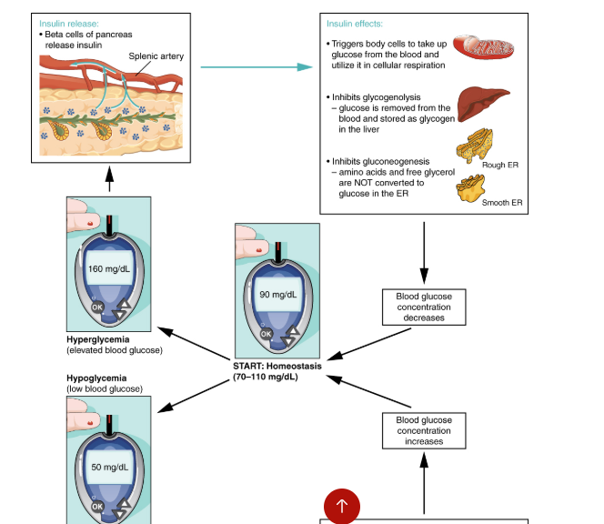
Regulation of Insulin secretion
Regulated by feedback effect of blood glucose level.

Slide 29
I.Effect of blood glucose level on Insulin secretion
Blood sugar level increase (100 - 120 mg/dl).
Rate of insulin secretion increases.
Biphasic effect of glucose.
Blood glucose increases.
Release of insulin into blood increases rapidly.
Concentration of insulin in plasma increases from the basal level.
Within 10 - 15 min, insulin conc. in blood is reduced to half the value.

Slide 30
After 15 - 20 min insulin secretion rises once again slowly but steadily
reached max btw 2 - 2 1/2hrs.
Prolonged insulin increase due to newly formed insulin from pancreas.

Slide 31
II. Effect of Protein on Insulin secretion
Excess of amino acids in the blood stimulates insulin secretion.
Potent AA are arginine and lysin.
AA potentiates the action of gucose on insulin secretion.

Slide 32
III.Effect of Lipid Derivatives on Insulin secretion
Betaketo acids - aceto acetate increases insulin secretion.

Slide 33
IV. Effect of Gastro Intestinal Hormones on Insulin secretion
Gastrin, secretin,CCK,GIP - causes insulin secretion.

Slide 34
V.Effect of other Endocrine hormones on Insulin secretion
Glucagon GH, cortisol - potentiating the action of increased blood sugar level on beta cells of islets of Langerhans in pancreas.

Slide 35
VI. Effect of Autonomic Nerves on Insulin secretion
Stimulation of right vagus to the pancreas increase secretion of insulin by Ach.choline.
Stimulation of sympathetic nerve inhibits the secretion by nor- adrenaline.

Slide 36
Glucagon
Source of secretion - A- cells or alpha cells in the islets of Langerhans of pancreas.

Slide 37
Chemistry
Chemistry - Glucagon is a polypeptide with a molecular weight of 3485.
It contains 29 amino acids.

Slide 38
Synthesis
Glucagon is synthesized from the preprohormone percursor called preproglucagon in the alpha cells of islets.

Slide 39
Actions of Glucagon
Antagonistic to those of insulin.
Increases blood sugar level.
Increases peripheral utilisation of lipids.
Facilitates the conversion of proteins into glucose.

Slide 40
I. Effect on Carbohydrate metabolism
Glucagon increases glycogenolysis in liver to Blood .
Glucagon doesnot induce glucogenolysis in muscles.
Glucagon increases Gluconeogenesis (Formation of glucose from proteins) in liver by :
(A) Activating the enzyme which convert pyruvate into phosphoenol pyruvate.
(B) Increasing the transport of AA into liver cells.
AA are utilized for glucose formation.

Slide 41
II. Effect on Lipid metabolism
Glucose shows lipolytic and ketogenic actions.
It increases release of free fatty acids from adipose tissue and makes it available for peripheral utilisation.
Promotes ketogenesis in liver.

Slide 42
III.Effect on Protein metabolism
Increases gluconeogenesis in liver.
By increasing the transport of AA into liver cells.

Slide 43
IV.Other actions
I. Increases the secretion of Bile
2.Inhibits the secretion of Gastric Juice

Slide 44
Mode of action
By activating the intra cellular enzyme system & formation of the second messenger cyclic AMP.

Slide 45
Regulation of Glucagon secretion
I.Effect of blood glucose level on Glucagon secretion
Hypoglycemia(blood glucose ( below 80mg/dl)
alpha cells of islets of Langerhans stimulated
Glucagon released.
blood gluose level
Hyperglycemea
alpha cells inhibited
secretion of glucagon decreased
blood glucose level

Slide 46
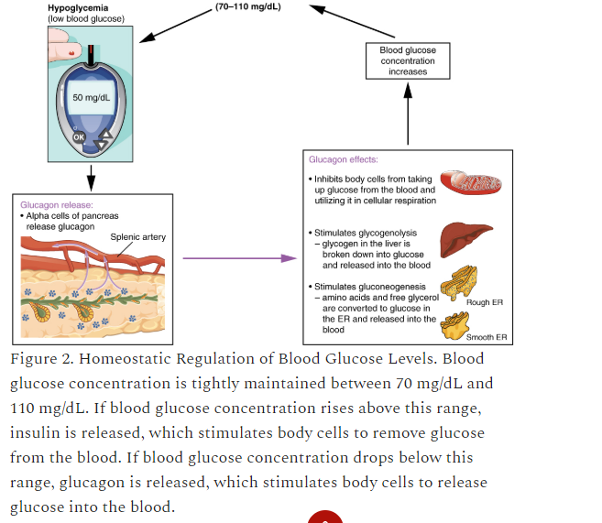

Slide 47
Effect of Aminoacid level on Glucagon secretion
Aminoacid in blood
stimulates glucagon secretion
Glucose

Slide 48
III.Effect of other factors on Glucagon secretion
Exercise
Stress
Gastrin Increases glucagon secretion
CCK
Cortisol
Somatostatin
Insulin
Fatty Acids Decreases glucagon secretion
Ketones

Slide 49
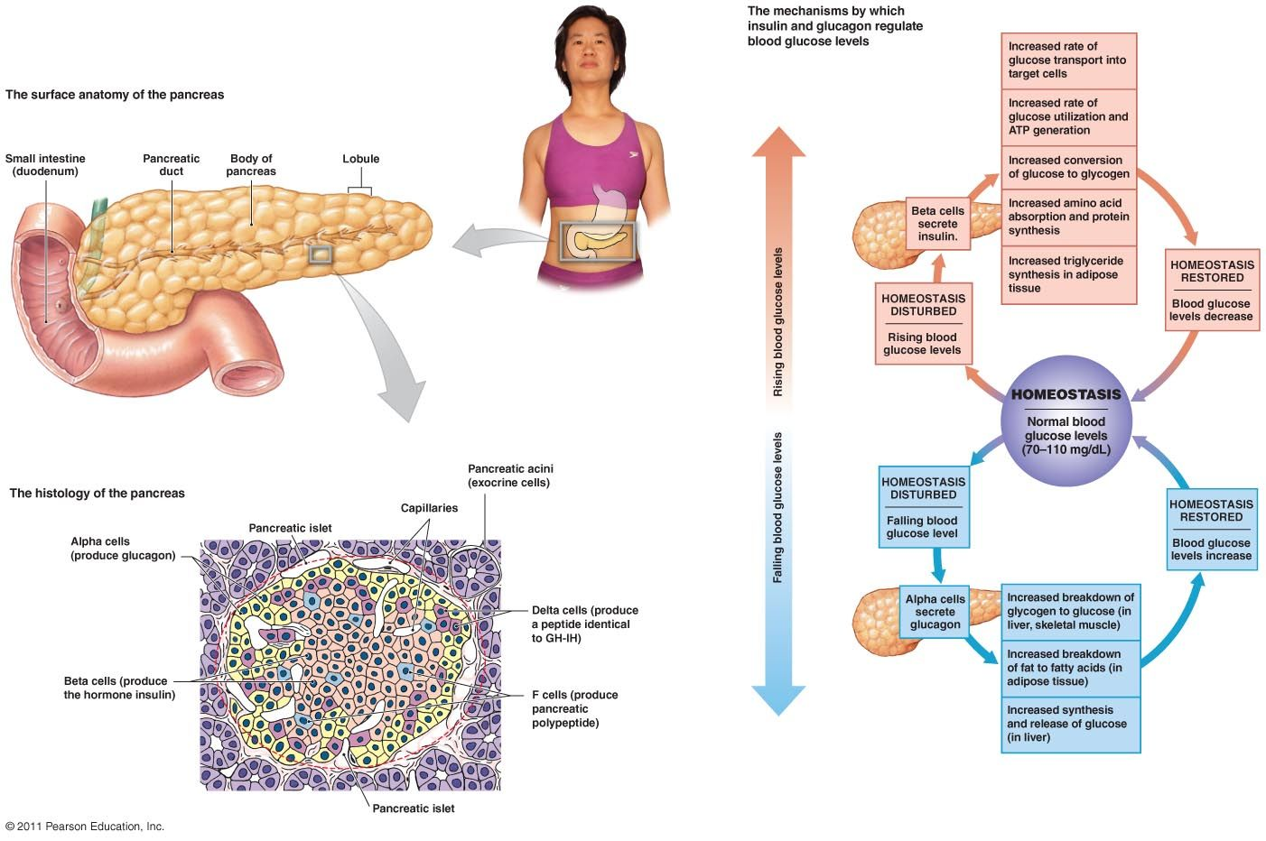
Regulation of blood glucose level

Slide 50
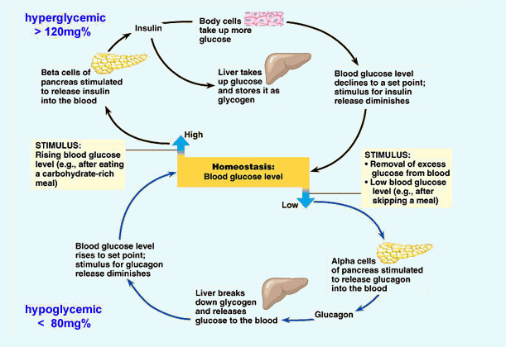

Slide 51
SOMATOSTATIN
SOURCE OF SECRETIOON
1.Hypothalamus
2.D cells in islets of Langerhans of pancreas
3.D cells in stomach, upper part of small intestine

Slide 52
Chemistry & Secretion
Somatostatin - 14(14 AA)
Somatostatin - 28(28 AA)
Synthesized from precursor pre somatostatin

Slide 53
Action of Somatostatin
Inhibits alpha and beta cells - Inhibits glucagon and insulin
Decreases the motility of stomach, duodenum, Gallblader.
Reduces secretion of GIP,VIP
Inhibits GH secretion from ant.pit.

Slide 54
Regulation of secretion of somatostatin
Secretion increased by glucose, AA,CCK
Tumor of D cells islets of Langerhans leads to Hyperglycemia
Presence of chyme containing glucose & proteins, SI

Slide 55
Pancreatic Polypeptide
Source of secretion& chemistry
Secreted from
F cells or PP cells in the islets of Langerhans, also in small intestine.
contains 36 AA

Slide 56
Action& Regulation of secretion
Action - increases the secretion of glucagon
Regulation - stimulated by presence of chyme with more protein in SI.

Slide 57
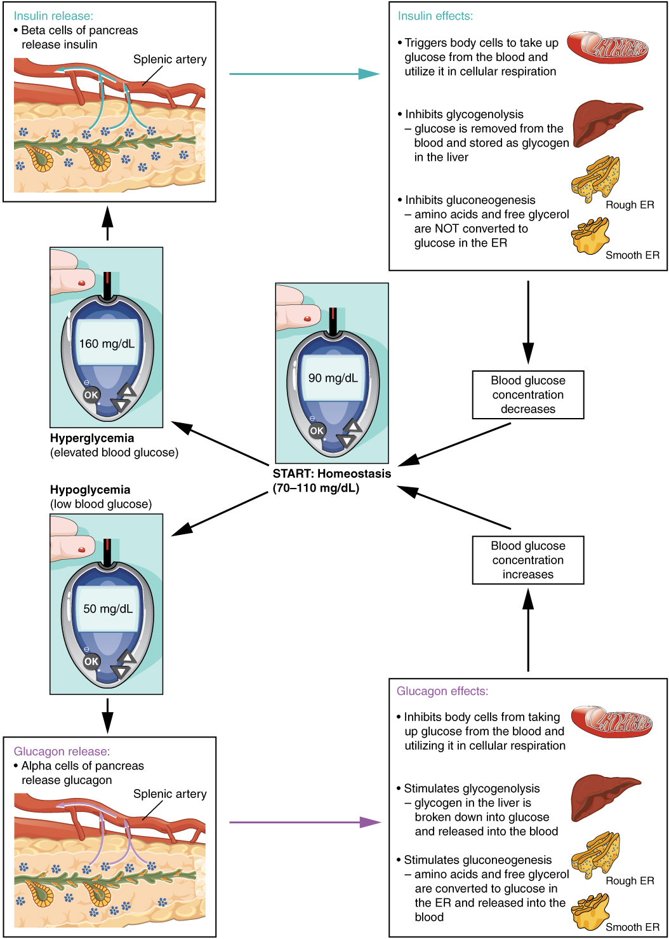

Slide 58
Maintenance of Blood Sugar level
FBS 80 - 90mg/dl of blood
PPBS 120 - 140mg/dl of blood
Blood sugar regulating mechanism operating through liver, muscles by the influence of insulin and glucagon.
Anti diabetogenic HORMONE - insulin
Glucose can be utilized by brain,retina and germinal epitelium of gonads.

Slide 59
Role of Liver in the maintenance of blood sugar level
Excess glucose is converted into glycogen and stored in liver.
Blood sugar level falls glycogen in liver is converted into glucose and released into the blood from the liver cells regulated by insulin and glucagon.

Slide 60
Role of Insulin in the maintenance of Blood sugar level
1. Transport & Uptake of Glucose
Insulin facilitates transport of glucose from blood into the cells by increasing the permiability of cell membrane to glucose.
Uptake of glucose by liver,muscles,adipose tissue by insulin.

Slide 61
2.Peripheral Utilization of Glucose
Rate of oxidation depends upon intake of glucose and glucose utilization is enhanced by insulin.

Slide 62
3. Storage of Glucose
Glycogenesis in muscles and liver.
Due to activation of enzymes necessary for glycogenesis by insulin.
Insulin causes convertion of glucose into fatty acids.

Slide 63
4. Inhibition of Glycogenolysis
Prevents break down of glucogen into glucose in muscles and liver.

Slide 64
5. Inhibition of Gluconeogenesis
Prevents the formation of glucose from proteins by:
Inhibiting the release of AA from muscles.
Inhibiting activities of enzymes involed in gluconeogenesis.
Insulin decreases blood sugar level by:
Facilitating the transport and uptake of glucose by the cells.
Increasing the peripheral utilization of glucose.
Convertion of glucose into glycogen in liver and muscles.
Prevention of glycogenolysis.
Inhibition of gluconeogenesis.

Slide 65
Role of Glucagon in the maintenance of Blood Sugar level
Glucagon increases glycogenolysis in liver - to blood.
Doesnot induce glycogenolysis in muscles
Glucagon increases gluconeogenesis in liver by activating the enzymes which convert pyruvate to phosphoenol pyruvate
Increasing transport of AA into the liver cells

Slide 66
Role of other hormones in the maintenance of blood sugar level
I. Growth Hormone
Decreases the peripheral utilization of glucose for the production of energy( During metabolism of fat), mobalization of fatty acids for energy production
Increase in the deposition of glycogen in the cells (-convert to glycogen)
Decrease in the uptake of glucose by the cells (blood glucose increases)
Diabetogenic effect of GH(-increase blood glucose level)

Slide 67
II.Cortisol
Increases gluconeogenesis in liver cells from AA
Decreases glucose uptake by the peripheral cells & utilization of glucose
Adrenal diabetes & Glucosuria
In adrenal insufficiency, fasting leads to death

Slide 68
Adrenalin
increases blood glucose by glycogenolysis in liver, muscles

Slide 69
4. Thyroxine
increases the absorption of glucose from GI tract
increases the break down of glycogen into glucose
accelerate the process of gluconeogenesis

Slide 70
Diabetes mellitus
Elevated blood sugar level due to reduced secretion of insulin by beta cells of islets of Langerhans

Slide 71
Type I Diabetes mellitus
due to deficiency of insulin- due to disorder or absence of beta cells
insulin dependent DM
not associated with obesity, with acidosis or ketosis
occur before 40 yrs of age
juvenile Diabetes - congenital disorder

Slide 72
causes
1. degeneration of beta cells in the islets
2. destruction of beta cells by viral infection
3. congenital disorder
4. auto immune disorder-development of auto immune disorder

Slide 73
Type II Diabetes Mellitus
occurs after 40 yrs of age-maturity onset Diabetes
very rarely associated with ketosis
NIDDM

Slide 74
Causes
absence or reduced number of insulin receptors in the cells of the body
inherited condition.

Slide 75
DM associated with other endocrine disorders
gigantism
acromegaly
cushings syndrome -constant stimulation of beta cells causes burning out & degeneration of beta cells.( secondary diabetes)

Slide 76
Signs & Symptoms of Diabetes Mellitus
increased blood sugar level 300-400 mg.dl due to reduced utilization by tissues
mobilization of fats from adipose tissue for energy purpose leading to elevated fatty acids
leads to atheroscelerosis
depletion of proteins from the tissues

Slide 77
Features
1.Loss of glucose in urine- above 180 mg/dl- Renal threshold level of glucose- glucosuria
2. Osmotic diuresis- reduction in the reabsorption of water inthe renal tubules---polyuria, polydipsia
3. polyuria
4. polydipsia- stimulation of thirst center of hypothalamus
5. polyphagia
6.Asthenia

Slide 78
6. Asthenia--decrease in protein synthesis
7. Acidosis--- ketoacids released, Acetone breathing
8. Kaussmaul breathing -rate & depth of respiration increases
9. Circulatory shock
10.Coma due to excess CO₂ loss ,hyperosmolarity of plasma

Slide 79
COMPLICATIONS
degenerative changes in the retina-Diabetic retinopathy
renal diseases- Diabetic nephopathy
loss of function ofautonomic & peripheral nerves -diabetes neuropathy

Slide 80
Hyperinsulinism
excessive secretion of insulin from pancreas
occurs due to the tumor of beta cells
signs& symptoms
Hypoglycemia
manifestation of CNS-Severe nervousness, tremor excessive sweating( neuroglycopenic symptoms)

Slide 81
THANK YOU
References
https://quizlet.com/253314142/pathology-of-the-endocrine-pancreas-diagram/
https://www.slideshare.net/nasirkopu/18-endocrine-pancreas
https://diabetesmellitustype2.weebly.com/answers.html

